Slide 1
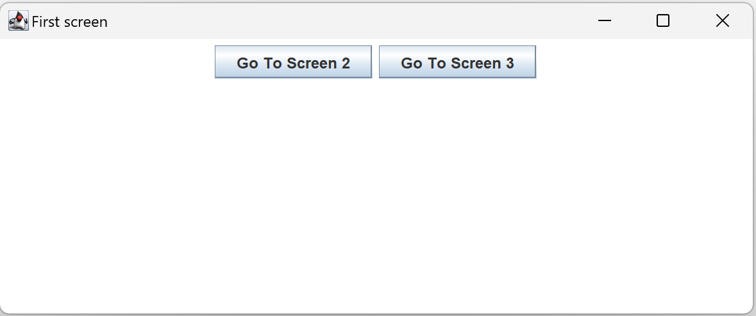
One Screen
Title
btn1 : JButton
btn2 : JButton
pane : Container
flowLayout

Slide 2
One Screen
Try the following:
Change the label for btn1 and btn2
Add two more JButton objects, btn3 and btn4

Slide 3
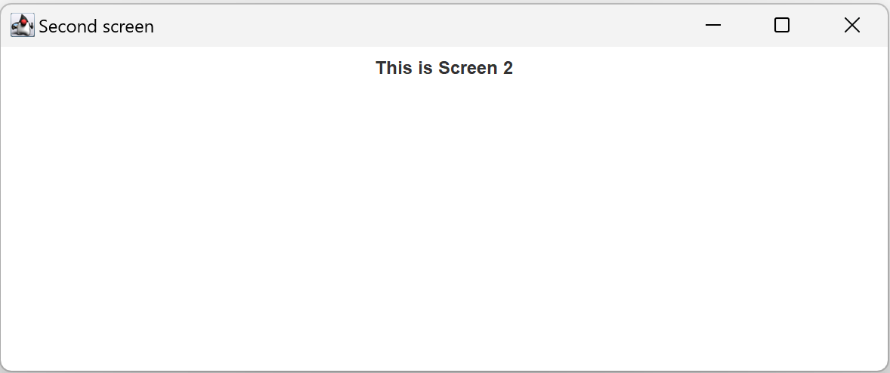
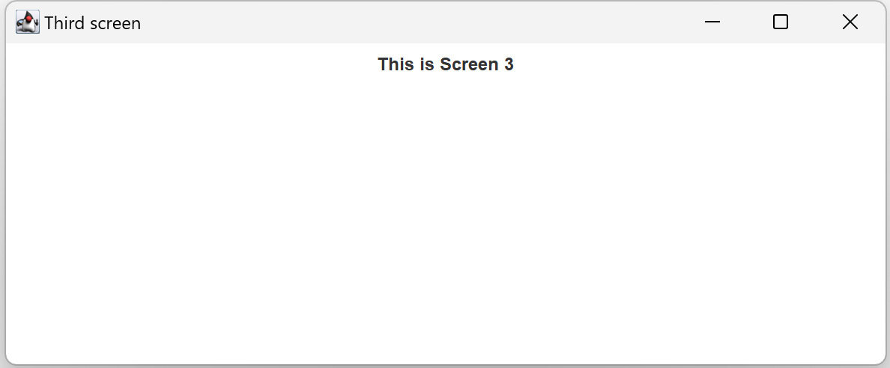
Multiple Screens
From Screen 1
go to either

Slide 4
Multiple Screens
Try the following:
Add one more JButton object, Go To Screen 4
Add one more screen, Screen4

Slide 5
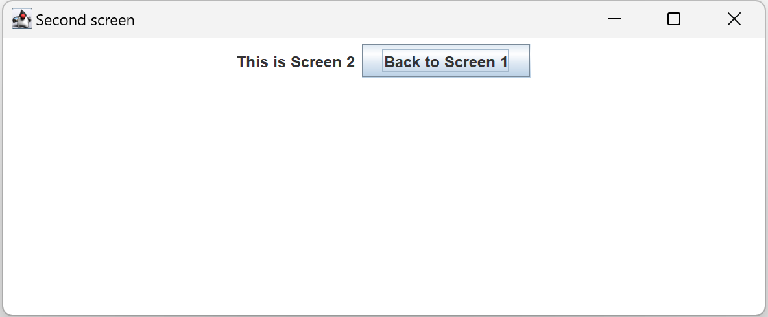
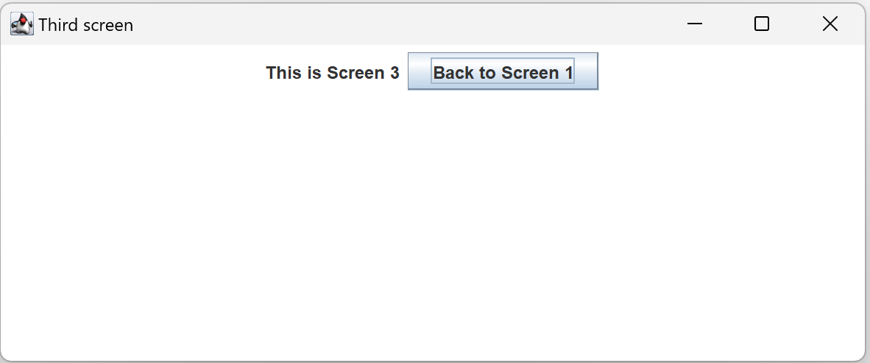
Multiple Screens with Back Button
Going back and forth from Screen 1 to Screen 2 and Screen 3

Slide 6
Multiple Screens with Back Button
Try the following:
Add one more JButton object, Go To Screen 4
Add one more screen, Screen4

Slide 7
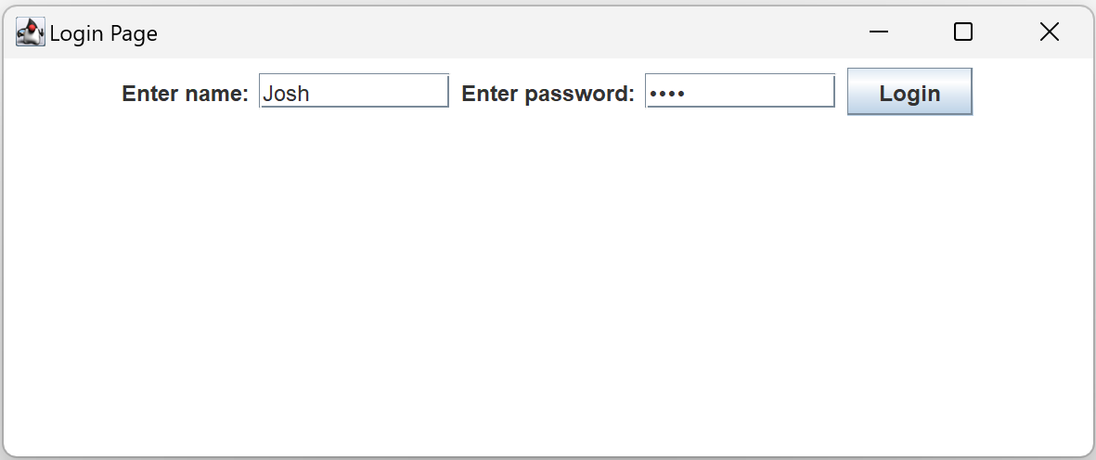
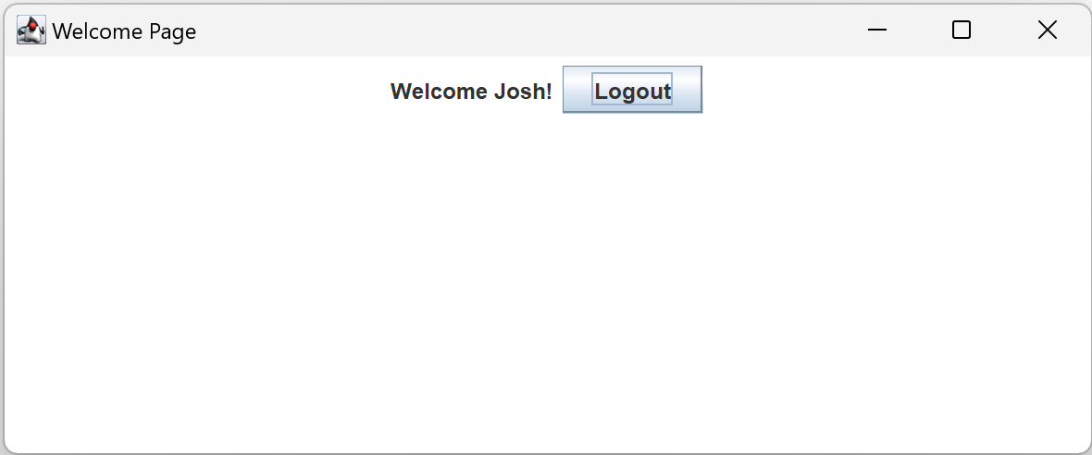
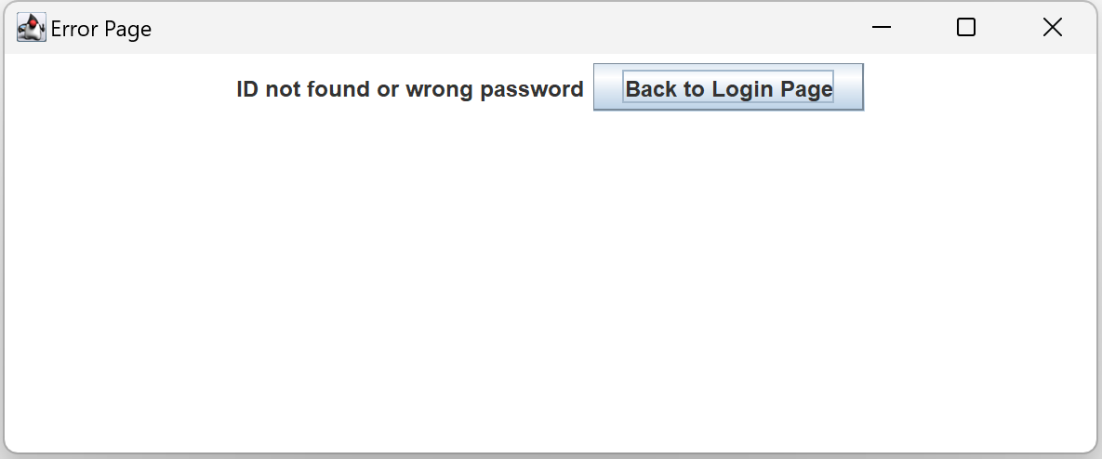
Login and Logout
Login with right ID and password;
Login with wrong ID or password;
Logout

Slide 8
Login and Logout
Try the following:
Add one more Member object in the Library:
new Member("Andy", "pwd2");

